Slide 1
LARSEN & TOUBRO INFOTECH

Slide 2
The Ask – Where we started
1. A client-server system to develop a course registration system.
2. The system should allow students to register for courses and view report cards.
3. Professors should be able to access the system to sign up to teach courses as well as record grades.
4. Admin is responsible for adding courses, assigning them to professor, approving student and course registration
5. The system should access course information from the course catalog database via open MySQL .

Slide 3
3 WEEKS OF TRAINING + PROJECT DEMO
15 DAYS
360 HOURS
21600 MINUTES
1296000 SECONDS
LIMITLESS KNOWLEDGE

Slide 4
Framework for 3 Weeks
3 weeks plan
Everyday Discussion about new topics and technologies to be integrated in the project assisted by doubt clearance to tackle the blockers faced.
Every day with discussions with SME on Project progress & transformation based on backend Technologies.

Slide 5
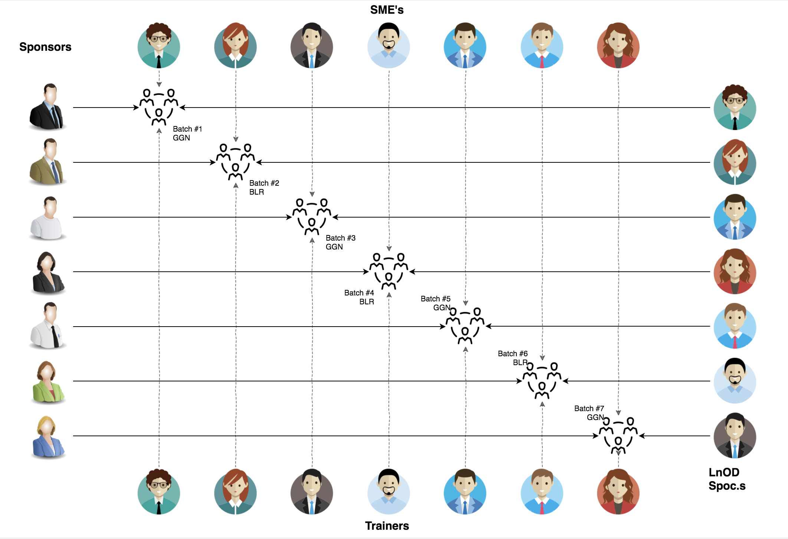
Stakeholders
Sponsors
LTI
2. SME’s
Amit Balyan

Slide 6
Our next starts
NOW
Notes:
Time – 1 min
Swati

Slide 7

Agenda
01
Our Journey
02
Our Team
03
Team Structure
04
Project Goals
05
Engineering Practices
06
Tech Stack
07
Development
08
Challenges & Learnings
09
Demo
10
Questions
11
Notes:
Time – 1 min

Slide 8

Our Journey
Notes:
Time - 2 mins

Slide 9
CRS
Mindset
Process
5
CRS Project
Tools
4
Adapting to a developer
Mindset
Comprehend
3
Design Thinking
2
Decide the Technologies JAVA/REST
1
Understanding Project Goals

Slide 10

Our Team
Notes:
Time – 2 mins

Slide 11
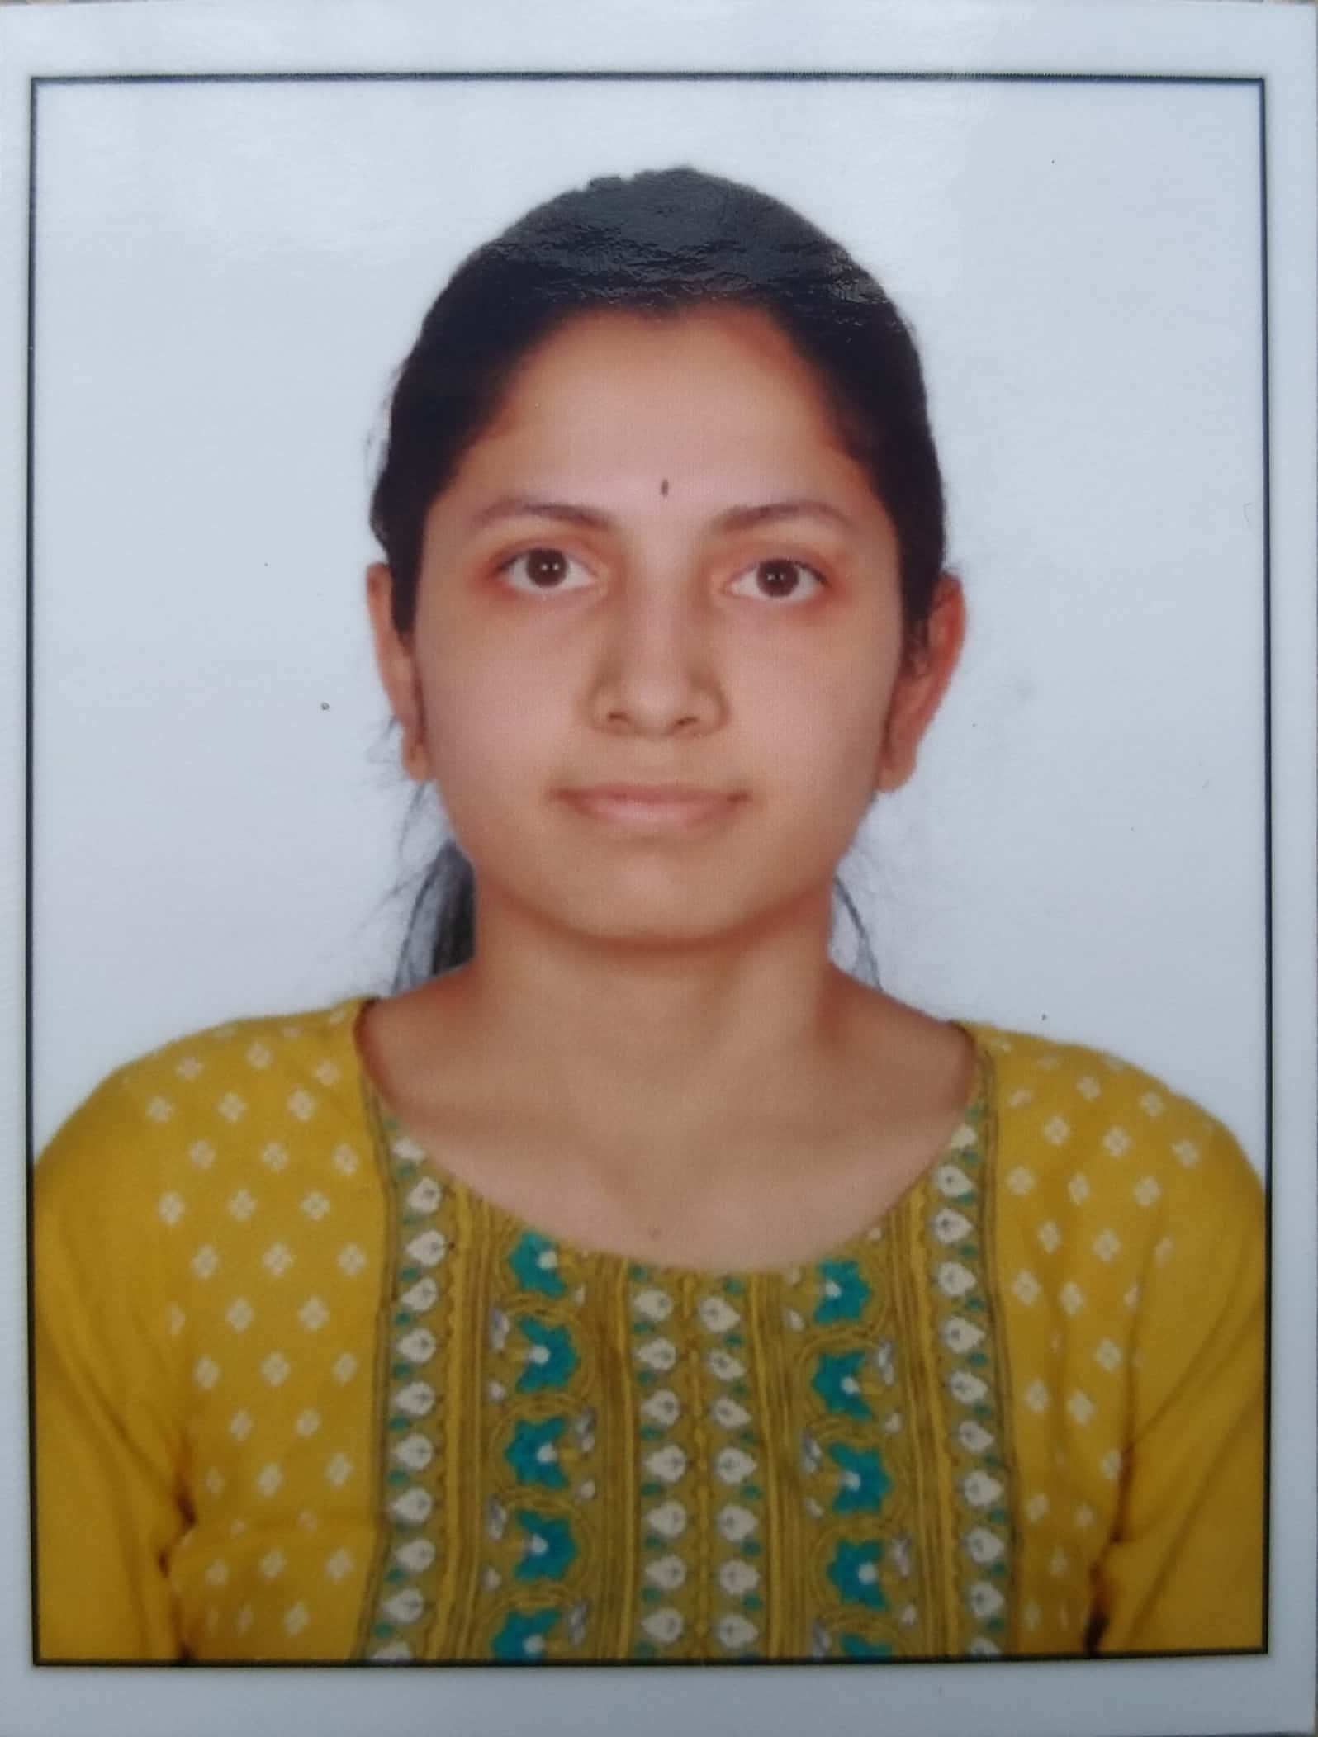
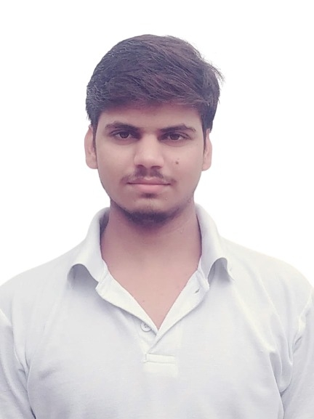
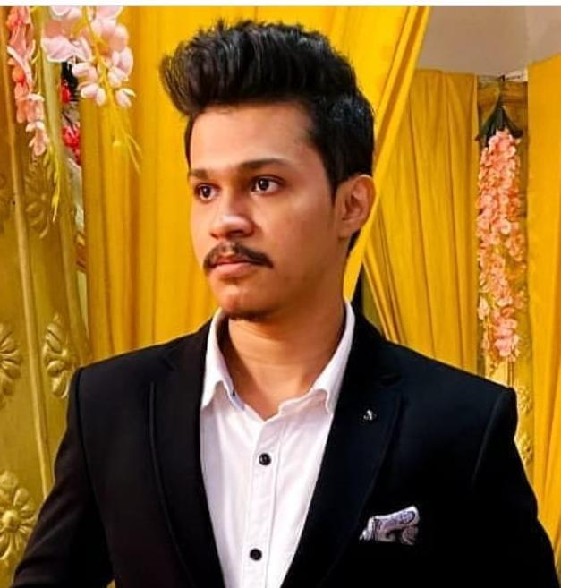
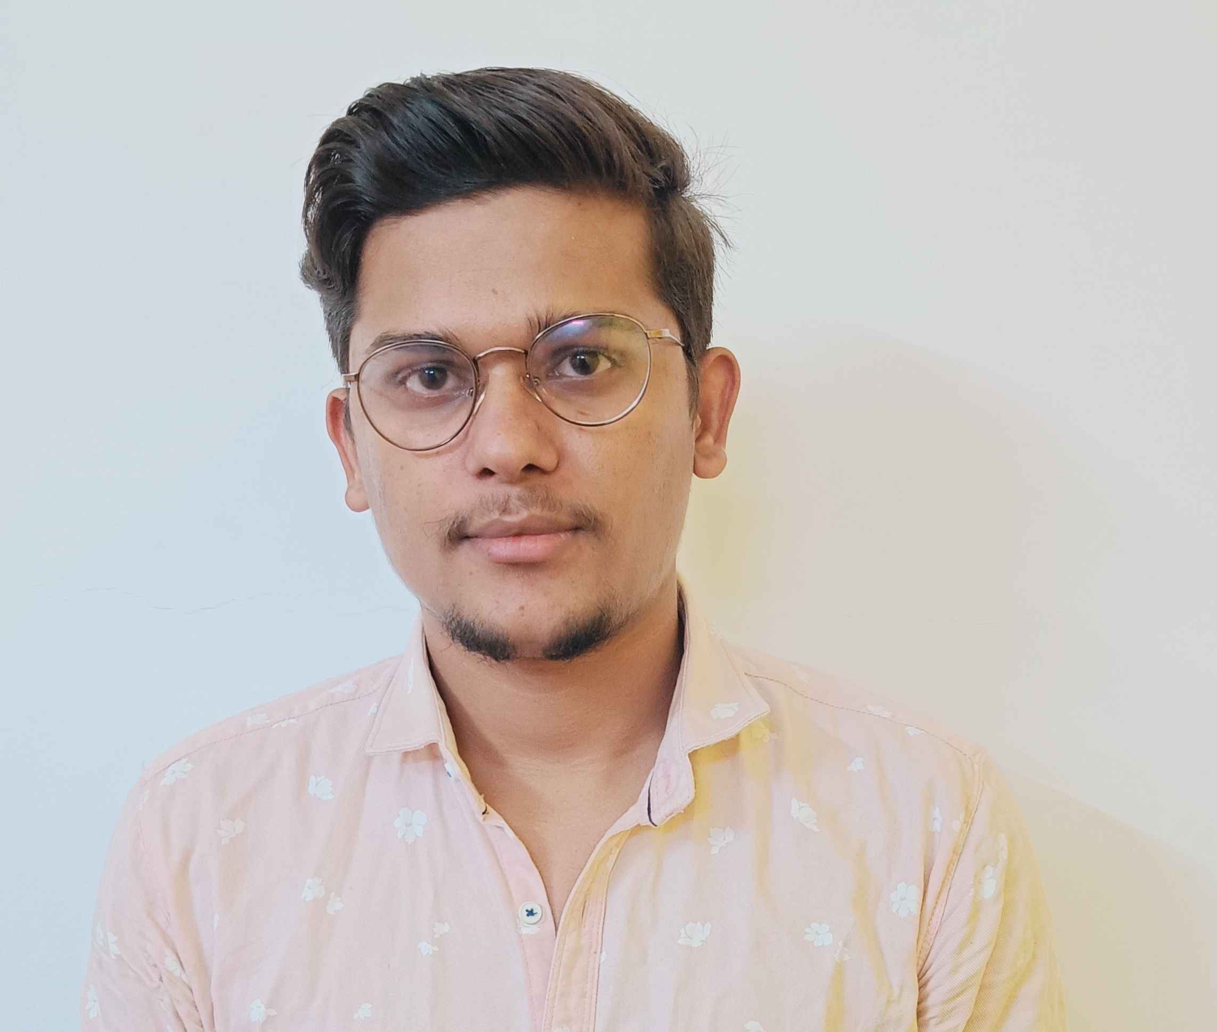
Amulya Abburi
Rohit Shakya
Kartik Patil
Kunal Kumar

Slide 12

Project Goals
Notes:
Time – 3 mins

Slide 13




Our Vision
To create a Course Registration System using full stack development tools and technologies, where a user can register as a student, professor or admin and an admin can approve new users and course registration.
1
2
Quality
Security
3
4
Interactivity
Speed
Notes:
User satisfaction and brand value

Slide 14

Engineering Practices
Notes:
Time – 5 mins

Slide 15
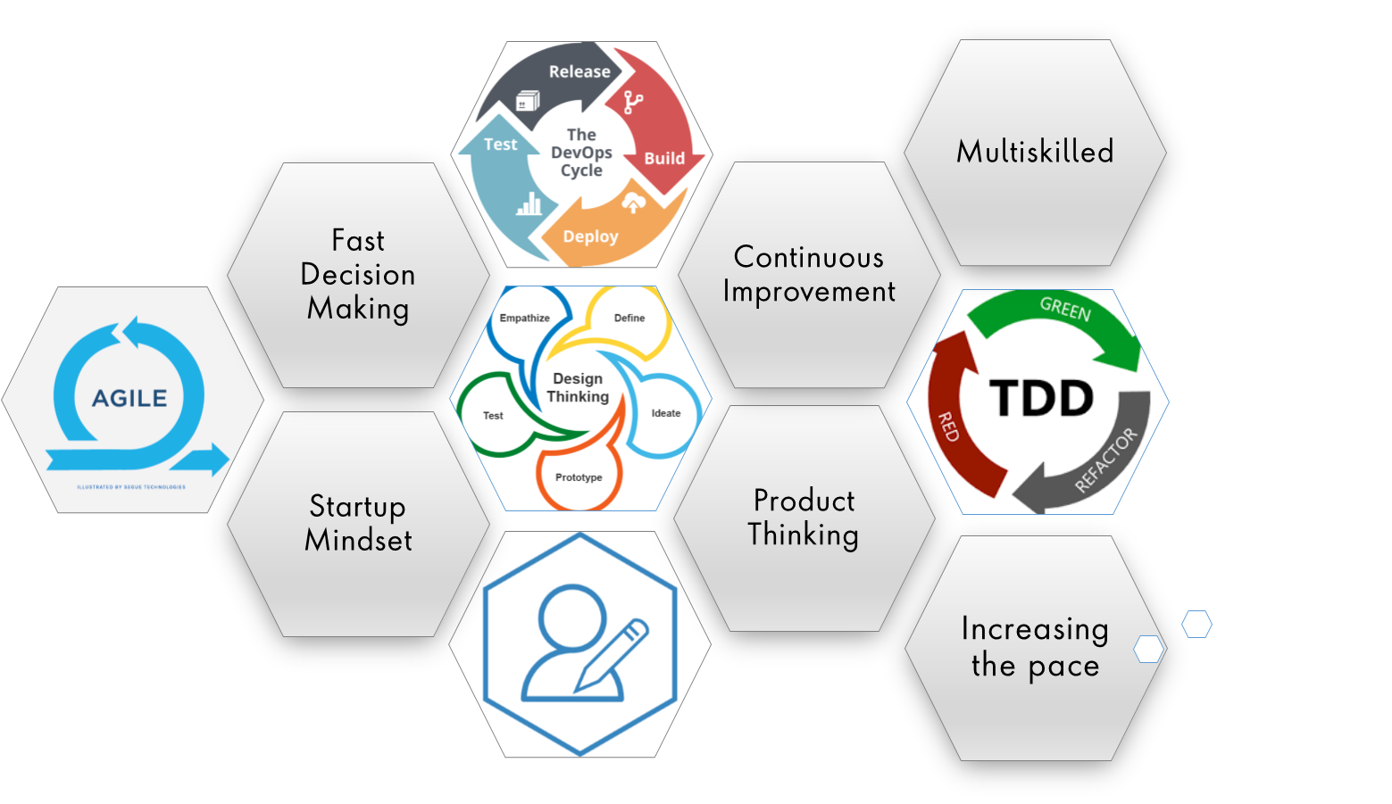
Notes:
Product Thinking (Design Thinking, Requirement Analysis, )
Multi Skilled (Frontend, Backend, DevOps)
Fast Decision Making (Agile)
Increasing the Pace (Automation CI/CD)
Startup Mindset (Agile)
Continuous Improvement (Retros)

Slide 16
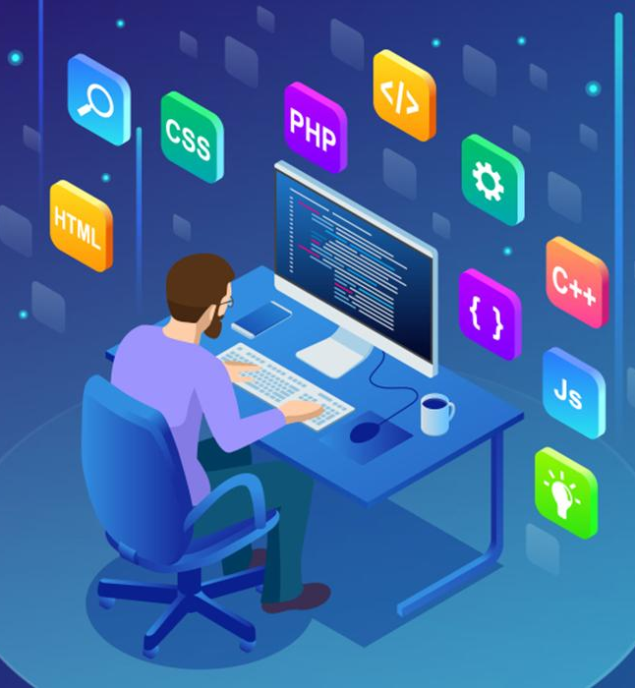
Tech Stack
Notes:
Time – 2 mins

Slide 17








Backend
Data
Tools
Core Language
SQL Database
Tools used
Framework
Notes:
Time – 1 min

Slide 18

Development
Notes:
Time – 1 min

Slide 19
Understand the tasks
Divide the tasks and assemble it when finished
Requirement understanding
Research and analysis
Estimation
Sprint Planning
Spring Grooming
Sprint Implementation
Delivery
LLD
Development
Code Review
Commit
Integrate
Deploy
Test
Notes:
Time – 1 min

Slide 20

Challenges & Learnings
Notes:
Time – 2 mins

Slide 21

Demo
Notes:
Time –
Architecture – 5 mins
NFR Dashboard – 3 mins
Demo – 10 mins
1. Show the Responsiveness and Wave tool first

Slide 22

Questions
Notes:
Time - ?

Slide 23
Thank you
Notes:
Time – After this show the testimonial video. 1 min

